Slide 1
APPROACH TO CORONARY BIFURCATION LESIONS
Dr.Santhosh Narayanan
SR Cardiology

Slide 2
Outline
Anatomy
Classification Systems
Medina System
MADS System
Important Stent Attributes for treating Bifurcation lesions
Bifurcation Treatment Techniques
Provisional Stenting
Two-stent
Clinical Evidence impacting current techniques
Summary

Slide 3
Any lesion with > 50% stenosis adjacent (< 5 mm) to
and/ or
at the ostium of a side branch (> 2 mm of
diameter)

Slide 4
Account for 16 -20 % of PCI's
Procedural complications – 9%
Restenosis as high as 36%

Slide 5
Bifurcation PCI Challenges
Anatomical Variations
Procedural Options
Vessel size variations
SB accessibility
SB takeoff angulations
Plaque distribution
Plaque volume
Plaque compliance
Peripheral Vascular Issues
Single vs double vs triple wire
Balloon predilation MB and SB
Plaque modification or debulking
Provisional vs multiple stents
DES vs BMS
Kiss?
Multiple Stent Strategies
Adjunctive Pharmacotherapy

Slide 6
SB angulation

Slide 7
The shear stress hypothesis
The outer walls of bifurcation points subjected to diastolic flow reversal, leads to oscillatory shear stress
Oscillatory (as versus laminar) shear stress is less efficient in stimulating eNOS.
Monocytes bind more avidly to areas of oscillatory shear than to areas subjected to linear shear.
oscillatory shear stress is proatherogenic

Slide 8
Classification
Sanborn
Lefevre
Safian
Duke
MEDINA
MOVAHED

Slide 10
MEDINA classification

Slide 13
Limitations
Does not take into account
Length of disease in the ostium of the S B
Length of the LMCA before the bifurcation
Trifurcation
Vessel angulation
No differentiation is made between a normal segment (lesion free segment) and a < 5 0 % lesion
presence of calcifications is not identified

Slide 15
One vs two stents
Important trials
NORDIC
NORDIC 2
BBC
CACTUS

Slide 21
When to use elective two stents?

Slide 24
Ramifications of coronary tree follow minimal energy cost in providing myocardial blood flow
Finet's law

Slide 26
OPTIMAL VIEW
For LMCA – RAO or LAO view with caudal inclination.
For LAD – D : AP with marked cranial angulations.
For LCx – OM : slight LAO or RAO with caudal angulations.
For distal RCA : AP with cranial angulations.

Slide 27
Stenting techniques
Provisional
Mainvessel stenting ± side branch angioplasty (Provisional) T-stenting,
TAP,
REVERSE INTERNAL CRUSH
REVERSE CULOTTE.
elective
Culotte-stenting
Crush technique (reverse crush) T TECHNIQUE AND TAP
V STENTING
Y STENTING(SKS technique)

Slide 28
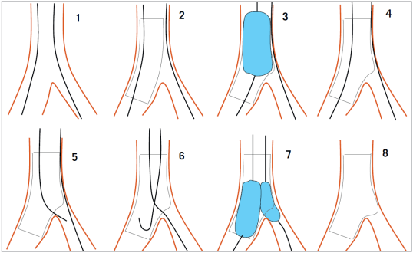
Provisional stenting strategy
Both branches are wired starting with the most difficult one
MB is stented (stent sized according to MB distal reference) and SB wire is jailed
The stent is post-dilated using the Proximal Optimization Technique (POT) to maximize stent apposition
Stent is now well apposed proximally, while the SB is partially covered by scaffolding
MB wire is pulled back and re-inserted through the most distal strut of the SB opening scaffold
Jailed wire is removed and re-inserted in the distal MB (with a formed loop at the distal end)
The Kissing Balloon inflation is done to optimize side branch flow and access
Final result (if suboptimal, can then place additional stents)

Slide 34
Modified T technique

Slide 35
V technique

Slide 37
Culotte technique

Slide 40
 It provides near-perfect coverage of the carina & SB ostium at the expense of an excess of metal covering in proximal MB.
Best immediate angiographic result & theoretically it may guarantee a more homogeneous distribution of struts & drug .
Can be used in all bifurcation lesions irrespective of bifurcation angle.
Open-cell stents are preferred when the SB diameter is >3 mm.
Disadvantages –
Complexity in the rewiring of both branches through the stent struts,
Not advisable if both branches are dissected after predilatation.

Slide 41
DK crush

Slide 43
immediate patency of both branches is assured & therefore it should be applied in conditions of instability or when the anatomy appears complex.
should be avoided in wide angle bifurcations.
Only SB has to be re-wired & not both branches as in culotte technique.
The crush technique has evolved and is nowadays performed with less stent
protrusion into the MB (i.e., mini-crush) & mandatory 2-step FKI.
crush” technique can therefore be considered as a sort of simplified “culottes” technique
The mini-crush may be associated with more complete endothelialisation and
easier re-crossing of the crushed stent.

Slide 44
Nordic I: provisional T stenting as good as systematic side branch stenting
Nordic II: Culotte better than Crush
Cactus: provisional T stenting not worse than crush
4 . BBC ONE: step wise approach with provisional T stenting better than initial complex procedures
5.Bad Krozingen: no difference provisional vs systematic T 6.Double Kiss Crush Study: DK Crush better than conv. crush
Steigen Circulation 2006; 114:1955; Erglis TCT 2008; Hildick-Smith TCT 200
Ferenc EHJ 2009; Chen J Interv Cardiol 2009; 22:121-27

Slide 50
Thank you

